Slide 1
矽瑪科技股份有限公司
Simula Technology Inc.
2024 Q3 Result Summary
2024/10/28

Slide 2
Agenda
1、Company Profile
2、2024 Q3 Financial Results
3、Business Update and Outlook
4、Q & A

Slide 3
Safe Harbor Notice
We have made forward-looking statements in the presentation. Our
forward-looking statements contain information regarding, among other
things, our financial conditions, future expansion plans and business
strategies. We have based these forward-looking statements on our
current expectations and projections about future events. Although we
believe that these expectations and projections are reasonable, such
forward-looking statements are inherently subject to risks, uncertainties,
and assumptions about us.
We undertake no obligation to publicly update or revise any forward-
looking statements whether as a result of new information, future events
or otherwise. In light of these risks, uncertainties and assumptions, the
forward-looking events might not occur and our actual results could
differ materially from those anticipated in these forward-looking
statements.

Slide 4
P&L - MoM
Company Profile
President JY HU

Slide 5
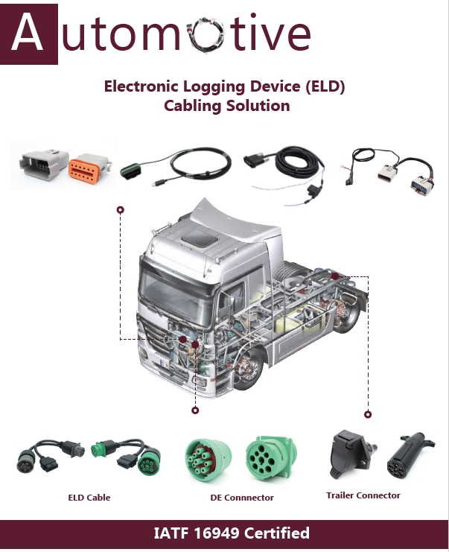
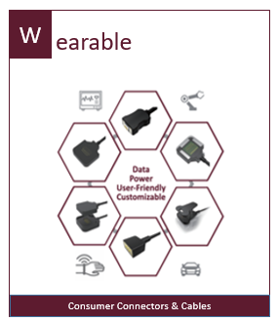
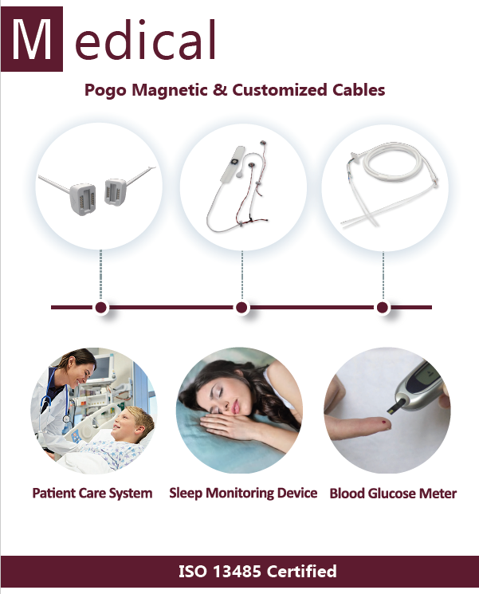
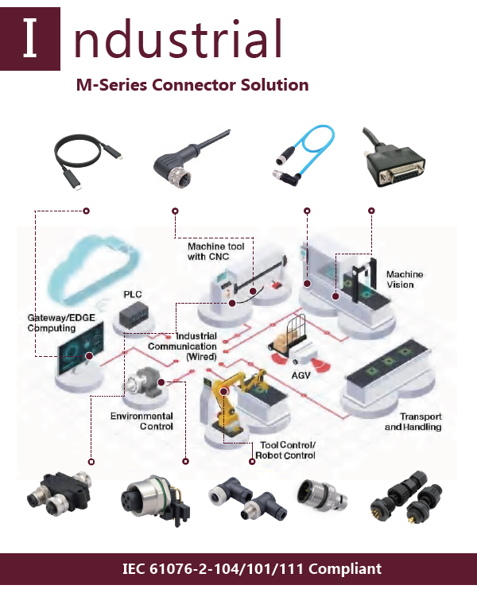
From parts to Key components and to Solution Provider
矽瑪科技股份有限公司
www.simulatechnology.com
1990 Established
2009 IPO
2020 Join Qisda Group
2021 Invest Action Star Co.
Employees: 750
Capital：NTD 799 M.
Sales Loacation：TW、USA、CN
Maunfacture Location：TW、CN
RD Loacation：TW、CN
2023 Revenue：NTD 2,039M
For the nine months ended 2024 Revenue：NTD 1,274M
Service from standard connectors、cables to the customized service
Focus on Automotive、Medical、Industrial、Consumer and Wearable fields.
Focus on EARLY STAGE and grow up with customers
Focus on HIGH ADDED VALUE products and business development(ex: ID design + Circuit Design + IC )
HQ： Taoyuan, Taiwan

Slide 6
P&L - MoM
2024 Q3 Financial Results
CFO Kevin Huang

Slide 7
Consolidated Statement of Comprehensive Income – 2024/Q3

Slide 8
Consolidated Statement of Comprehensive Income-2024Q1~Q3

Slide 9
Consolidated Balance Sheets – 2024/09/30

Slide 10
Key Financial Ratios (Consolidated)

Slide 11

P&L - MoM
Business Update and Outlook
President JY HU

Slide 12
Business Update
Revenue and gross margin decline, inventory decline
Continuously increase revenues and cost savings, effectively control operating expenses.
Orders from automotive gradually picked up in Q3 and profits increased.
In line with customer needs, increase the ratio of MIT.

Slide 13
Outlook
In response to tariffs and customer’s needs, continuously increase the ratio of MIT.
By semi-automating production in Taiwan and increasing the ratio of MIT, we will be able to increase production capacity and secure more orders for automotive cable business.
Evaluate connector automation solution to reduce cost and supply to contracted manufacturer locally.
Accelerate self-development and M&A of high-frequency cables to capture the market trend aligned with the Group's resources.

Slide 14
P&L - MoM
Q & A

